Slide 1
Help Wanted Online
A real-time measure of job postings
January 2025
Office of Research
Connecticut Department of Labor
Connecticut Department of Labor – Research Office
200 Folly Brook Blvd.
Wethersfield, CT 06109
Help Wanted Online

Slide 2
What is HWOL?
The Conference Board Help Wanted Online® Data Series (HWOL) measures the number of new, first-time Online job postings and jobs reposted from the previous month for over 50,000 Internet job boards, corporate boards and smaller job sites that serve niche markets and smaller geographic areas.
Connecticut Department of Labor – Research Office
200 Folly Brook Blvd.
Wethersfield, CT 06109
Help Wanted Online

Slide 3
Upcoming Release Dates
Monthly Report:
February 19th, 2025
Weekly New Ads Report:
Updated every Tuesday
Connecticut Department of Labor – Research Office
200 Folly Brook Blvd.
Wethersfield, CT 06109
Help Wanted Online

Slide 4
Statewide Weekly HWOL New Job Ads
Information on weekly new job ads by Employer, Industry, and Occupation can be found at:
https://www1.ctdol.state.ct.us/lmi/hwol.asp
This Information is updated every Tuesday.
Connecticut Department of Labor – Research Office
200 Folly Brook Blvd.
Wethersfield, CT 06109
Help Wanted Online

Slide 5
Statewide Monthly Highlights
- Total postings in Connecticut was 69,388 in December 2024, down from a November 2024 posting count of 74,139.
-Industry sectors with the most job postings were Health Care and Social Assistance (14,958 postings), Retail Trade (7,272 postings), Manufacturing (5,189 postings), and Professional, Scientific, & Technical Occupations
(4,612 postings).
-Occupations with the most postings were Registered Nurses (4,315 postings), Retail Salespersons (2,647 postings), Home Health & Personal Care Aides (1,776 postings), and Supervisors of Retail Sales Workers (1,402 postings).
Connecticut Department of Labor – Research Office
200 Folly Brook Blvd.
Wethersfield, CT 06109
Help Wanted Online

Slide 6
Top Qualifications in Connecticut Job Ads
Connecticut Department of Labor – Research Office
200 Folly Brook Blvd.
Wethersfield, CT 06109
Help Wanted Online

Slide 7
Top Skills in Connecticut Job Ads
Connecticut Department of Labor – Research Office
200 Folly Brook Blvd.
Wethersfield, CT 06109
Help Wanted Online

Slide 8
Connecticut Department of Labor – Research Office
200 Folly Brook Blvd.
Wethersfield, CT 06109
Help Wanted Online

Slide 9
Connecticut Employers with the Most Job Ads
Connecticut Department of Labor – Research Office
200 Folly Brook Blvd.
Wethersfield, CT 06109
Help Wanted Online

Slide 10
Connecticut Occupations with the Most Job Ads
Connecticut Department of Labor – Research Office
200 Folly Brook Blvd.
Wethersfield, CT 06109
Help Wanted Online

Slide 11
Top Occupations in Industries With The Most Ads
Connecticut Department of Labor – Research Office
200 Folly Brook Blvd.
Wethersfield, CT 06109
Help Wanted Online

Slide 12
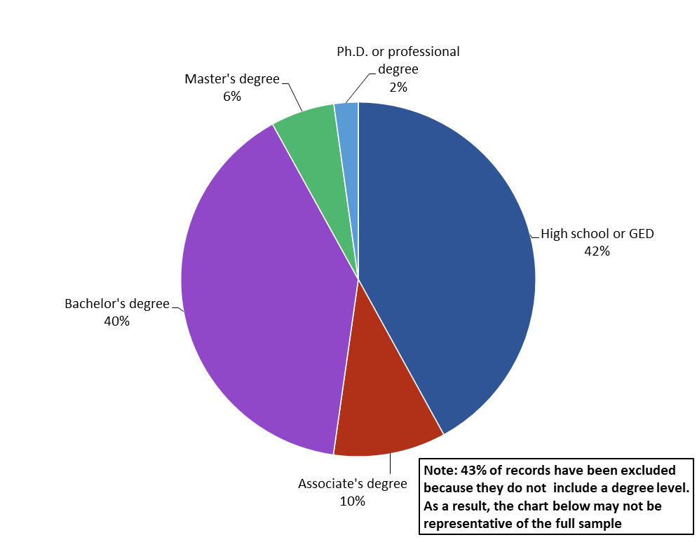
Connecticut Job Ads by Educational Requirements
Connecticut Department of Labor – Research Office
200 Folly Brook Blvd.
Wethersfield, CT 06109
Help Wanted Online

Slide 13
Workforce Area Data
Workforce Area Highlights
Job Ads by Industry
Job Ads by Location
Employers With The Most Job Ads
Occupations With The Most Job Ads
Connecticut Department of Labor – Research Office
200 Folly Brook Blvd.
Wethersfield, CT 06109
Help Wanted Online

Slide 14
Workforce Area Highlights
Connecticut Department of Labor – Research Office
200 Folly Brook Blvd.
Wethersfield, CT 06109
Help Wanted Online

Slide 15
Connecticut Department of Labor – Research Office
200 Folly Brook Blvd.
Wethersfield, CT 06109
Help Wanted Online

Slide 16
Eastern Workforce Job Ads by Location
Connecticut Department of Labor – Research Office
200 Folly Brook Blvd.
Wethersfield, CT 06109
Help Wanted Online

Slide 17
Eastern Workforce Employers
with the Most Job Ads
Connecticut Department of Labor – Research Office
200 Folly Brook Blvd.
Wethersfield, CT 06109
Help Wanted Online

Slide 18
Eastern WDA Occupations
with the Most Job Ads
Connecticut Department of Labor – Research Office
200 Folly Brook Blvd.
Wethersfield, CT 06109
Help Wanted Online

Slide 19
Connecticut Department of Labor – Research Office
200 Folly Brook Blvd.
Wethersfield, CT 06109
Help Wanted Online
19

Slide 20
North Central WDA Job Ads by Location
Connecticut Department of Labor – Research Office
200 Folly Brook Blvd.
Wethersfield, CT 06109
Help Wanted Online

Slide 21
North Central WDA Employers
with the Most Job Ads
Connecticut Department of Labor – Research Office
200 Folly Brook Blvd.
Wethersfield, CT 06109
Help Wanted Online

Slide 22
North Central WDA Occupations
with the Most Job Ads
Connecticut Department of Labor – Research Office
200 Folly Brook Blvd.
Wethersfield, CT 06109
Help Wanted Online

Slide 23
Connecticut Department of Labor – Research Office
200 Folly Brook Blvd.
Wethersfield, CT 06109
Help Wanted Online

Slide 24
Northwest WDA Job Ads by Location
Connecticut Department of Labor – Research Office
200 Folly Brook Blvd.
Wethersfield, CT 06109
Help Wanted Online

Slide 25
Northwest WDA Employers
with the Most Job Ads
Connecticut Department of Labor – Research Office
200 Folly Brook Blvd.
Wethersfield, CT 06109
Help Wanted Online

Slide 26
Northwest WDA Occupations
with the Most Job Ads
Connecticut Department of Labor – Research Office
200 Folly Brook Blvd.
Wethersfield, CT 06109
Help Wanted Online

Slide 27
Connecticut Department of Labor – Research Office
200 Folly Brook Blvd.
Wethersfield, CT 06109
Help Wanted Online

Slide 28
South Central WDA Job Ads by Location
Connecticut Department of Labor – Research Office
200 Folly Brook Blvd.
Wethersfield, CT 06109
Help Wanted Online

Slide 29
South Central WDA Employers
with the Most Job Ads
Connecticut Department of Labor – Research Office
200 Folly Brook Blvd.
Wethersfield, CT 06109
Help Wanted Online

Slide 30
South Central WDA Occupations
with the Most Job Ads
Connecticut Department of Labor – Research Office
200 Folly Brook Blvd.
Wethersfield, CT 06109
Help Wanted Online

Slide 31
Connecticut Department of Labor – Research Office
200 Folly Brook Blvd.
Wethersfield, CT 06109
Help Wanted Online

Slide 32
Southwest WDA Job Ads by Location
Connecticut Department of Labor – Research Office
200 Folly Brook Blvd.
Wethersfield, CT 06109
Help Wanted Online

Slide 33
Southwest WDA Employers
with the Most Job Ads
Connecticut Department of Labor – Research Office
200 Folly Brook Blvd.
Wethersfield, CT 06109
Help Wanted Online

Slide 34
Southwest WDA Occupations
with the Most Job Ads
Connecticut Department of Labor – Research Office
200 Folly Brook Blvd.
Wethersfield, CT 06109
Help Wanted Online

Slide 35
All advertisement data used in this publication is from the Conference Board’s Help Wanted Online data series.
For more information or data requests, contact Matthew Krzyzek in the Office of Research at the Department of Labor.
Matthew.Krzyzek@ct.gov
For more Connecticut Labor Market Information visit:
www.ctdol.state.ct.us/lmi
https://www.facebook.com/ctlmi
Twitter: @DOL_Research
Connecticut Department of Labor – Research Office
200 Folly Brook Blvd.
Wethersfield, CT 06109
Help Wanted Online

